Slide 1
Cell Jeopardy
Final Jeopardy
Cell types | Organelles | More Organelles | Cell application | Cell Pictures!
200
200
200
200
200
400
400
400
400
400
600
600
600
600
600
800
800
800
800
800
1000
1000
1000
1000
1000

Slide 2
2
This is a type of cell without a nucleus and no membrane-bound organelles.

Slide 3
3
What is prokaryotic?

Slide 4
4
This term describes a cell with a nucleus and with membrane-bound organelles.

Slide 5
5
What is Eukaryotic?

Slide 6
6
This organelle is responsible for coordinating the cell activities and reproduction; sometimes called the “brain” of the cell.

Slide 7
7
What is the nucleus?

Slide 8
8
This cell type has a cell wall, chloroplasts, and often a big vacuole.

Slide 9
9
What is a plant cell?

Slide 10
10
Daily Double
This organelle only appears in plant cells and provides structure and support for the cell because it is made of cellulose.
Daily Double

Slide 11
11
What is a cell wall?

Slide 12
12
Proteins are made by this organelle

Slide 13
13
What is a ribosome?

Slide 14
14
This organelle produces, stores, and releases most of the energy needed by the cell; sometimes called the “powerhouse” of the cell.

Slide 15
15
What is a mitochondria?

Slide 16
16
This organelle is used to package materials for export out of the cell or movement around inside the cell.
--This is a system of membranes that usually surround the nucleus.

Slide 17
17
What is the endoplasmic reticulum?

Slide 18
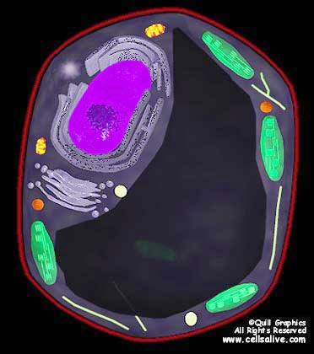
18
Name this organelle and describe its function.

Slide 19
19
What is the chloroplast?
--Makes food for plant
--holds chlorophyll
--uses light energy to make sugar from CO2 & H2O

Slide 20
20
Name these two structures found in plant cells

Slide 21
21
What is:
1) vacuole
2) cell wall

Slide 22
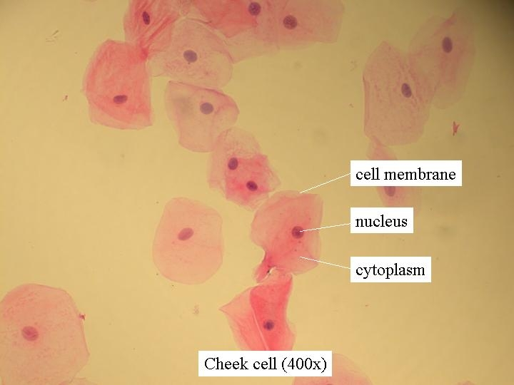
22
2
1
3
Name the three structures in this picture of human cheek cells. (must have all 3)

Slide 23
23

Slide 24
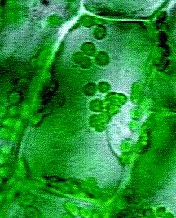
24
The arrow is pointing to the _________ in a plant cell.

Slide 25
25
What is a chloroplast?

Slide 26
26
This organelle modifies, packages and transports materials out of the cell.

Slide 27
27
What is are the
Golgi Bodies?

Slide 28
28
This jelly-like material flows inside the cell membrane around all of the organelles.

Slide 29
29
What is the cytoplasm?

Slide 30
30
This is the protective layer around all cells and it regulates what goes into and out of the cell.

Slide 31
31
What is the cell membrane?

Slide 32
32
What digests worn out organelles, breaks down food molecules, and cell wastes?

Slide 33
33
What is a lysosome?

Slide 34
34
What is the difference between Rough endoplasmic reticulum and Smooth ER?

Slide 35
35
--Rough ER is ER that has ribosomes attached.
--Smooth ER has NO ribosomes attached.

Slide 36
36
Which of the following would you not find in a bacterial (prokaryotic) cell?
-ribosomes
-cell membrane
-golgi bodies
-DNA
DAILY DOUBLE
DAILY DOUBLE

Slide 37
37
What is golgi bodies?

Slide 38
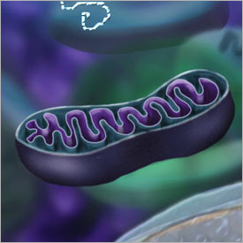
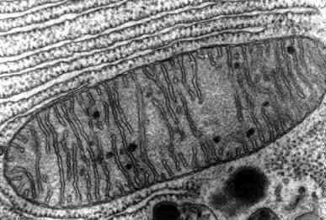
38
What organelle is shown in these pictures?

Slide 39
39
What is mitochondria?

Slide 40
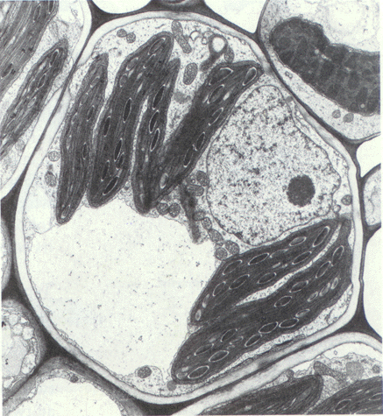
40
What does the structure do that the arrow is pointing to?

Slide 41
41
The vacuole stores water, waste, food and other cellular materials until the cell needs it.

Slide 42
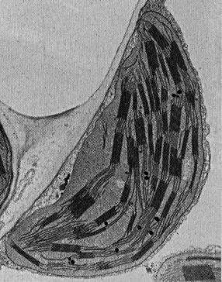
42
This organelle is found only in plant cells. What is it?

Slide 43
43
Chloroplast

Slide 44
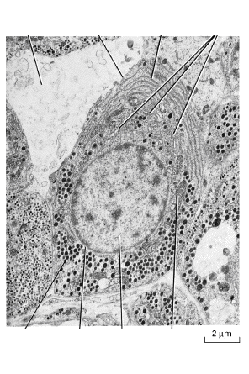
44
Is this a picture of a plant or an animal cell?

Slide 45
45
What is an animal cell?

Slide 46
46
Identify what the arrows are pointing to on this picture of a corn cell.
A
B

Slide 47
47
Chloroplast and vacuole

Slide 48
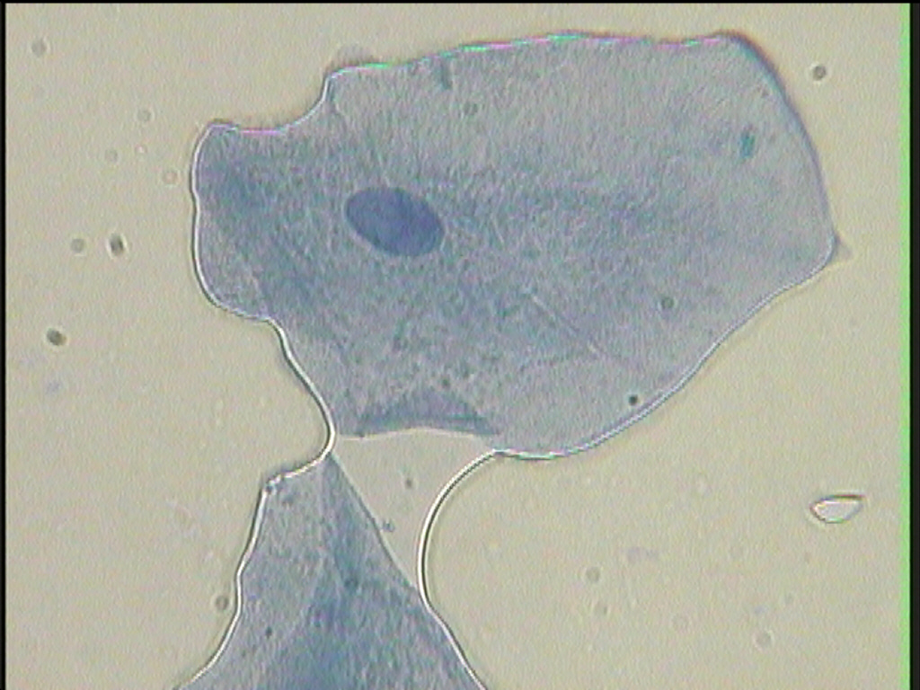
40
.
Name this and this

Slide 49
49
Cytoplasm and membrane

Slide 50
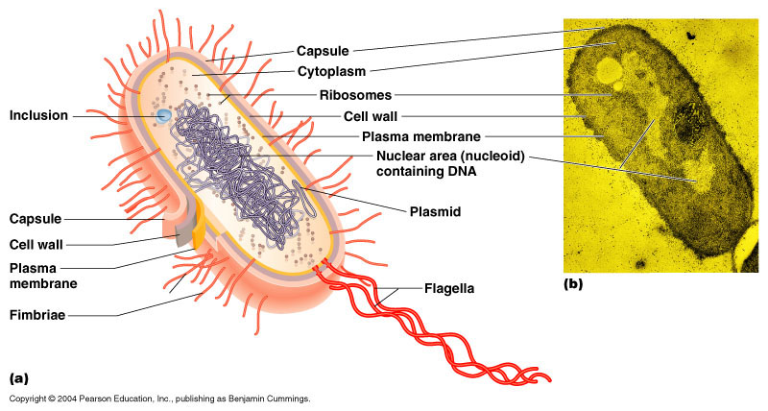
50
What is the scientific name for the
“tail-like” organelle in the purple circle?

Slide 51
51
What is flagella?

Slide 52
52
FINAL JEOPARDY
List two differences between
plant and animal cells.

Slide 53
53
What is plants have a cell wall, and chloroplasts that animal cells do not have?
--other answers too

